Slide 1


8.0.3
User Guide

Slide 2
Contents
User Guide V8
Homepage:
Access to content/Synchronisation
Synchronisation history
The “Start the presentation” button
Access to settings/notifications
Notifications
Settings
The 4 Browse Modes
Browsing in the tree structure
“Offline” mode
Supported content
Managing a PDF
Microsoft Office content
Media
Forms
Sharing:
Selecting content
                Adding recipients
Composing your message
Sharing content, continued
Presentations:
“Prepared” presentations
Creating presentations
“To send” Presentation
“Archives” Presentation
Your favourites
Your User Space
Updating your application

Slide 3

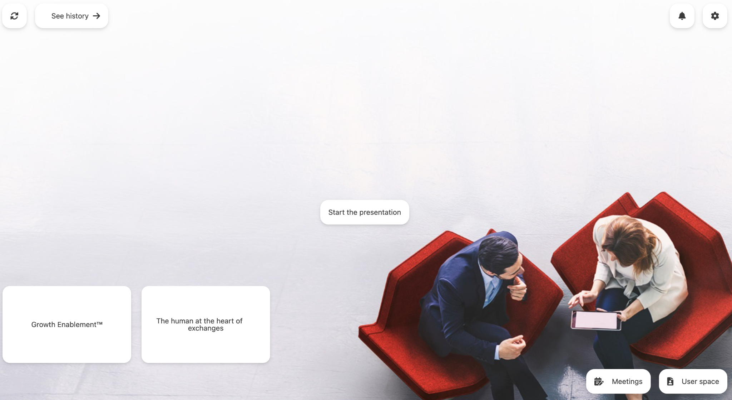
Homepage
User Guide V8
The Homepage in 5 zones:
█ Access to new content/Synchronisation
█ Access to settings/notifications
█ The Start Presentation button
█ Quick access to an appointment
█ Managing your Appointments/User Space
Back to contents

Slide 4
Homepage | Access to content / Synchronisation
User Guide V8
Synchronisation is automatic when the application is launched. It enables you to retrieve all content made available by your administrator. You’re sure to have access to the most recent content!
Once it’s synchronised, all your content is available “offline”.
In the upper left-hand corner, you have access to information on your synchronisation.
The two buttons are dynamic.
You’ll be alerted in the event of error; a blue disc will appear if you have new content.
█ Access to synchronisation history
█ A button to launch a synchronisation
Back to contents

Slide 5
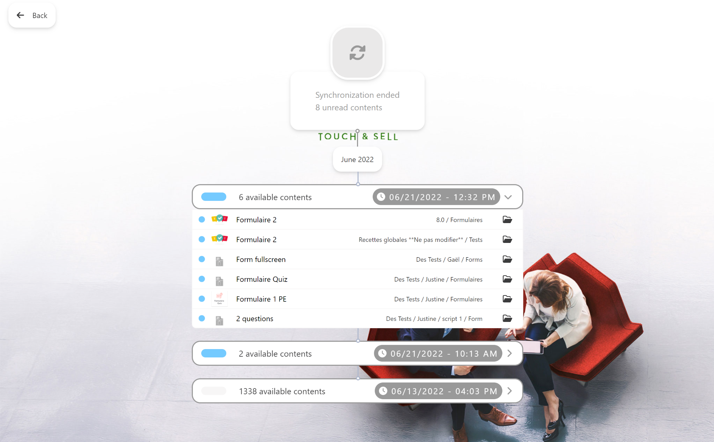
Homepage | Synchronisation history
User Guide V8
This section gives access to:
dates of synchronisations
lists of synchronised elements
It’s possible to:
█ Consult new content: click on the miniature and the content opens. You can return to the synchronisation section by closing content using the “Back” button.
█ See content in context: click on the path and the content is presented in its folder; the user’s focus is on the content.
When an item of content is opened, it’s marked as read. All content can be marked as read from the full list of the synchronisation event.
Back to contents
Notes:
Remarque VF : Slide 5 : pour un rendu optimal, préciser image en format .png pour avoir l'effet de transparence comme sur une miniature = c’est un guide user pas admin

Slide 6
Homepage | The Start Presentation button
User Guide V8
The button in the middle of the page enables you to start a presentation.
When you do so, the application memorises all the documents consulted during the presentation.
Once the presentation is over, the documents reviewed will be made available for sharing with your interlocutor.
All you need do is check your content, add to it if necessary, and send it all via a pre-drafted email with a simple click!
Back to contents

Slide 7
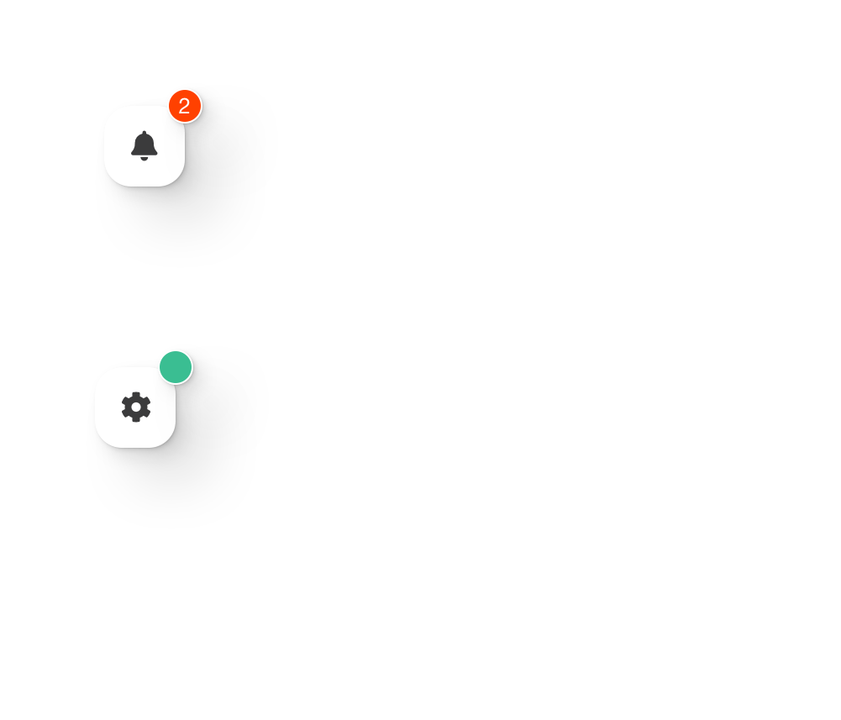
Homepage | Access to settings/notifications
User Guide V8
In the upper right-hand corner, you can
access notifications and your application’s settings.
The first button gives you access to the notifications screen.
The second button gives you access to the settings screen.
New notifications are indicated by a red disc.
When an update is available, it’s indicated by a green disc.
Back to contents

Slide 8
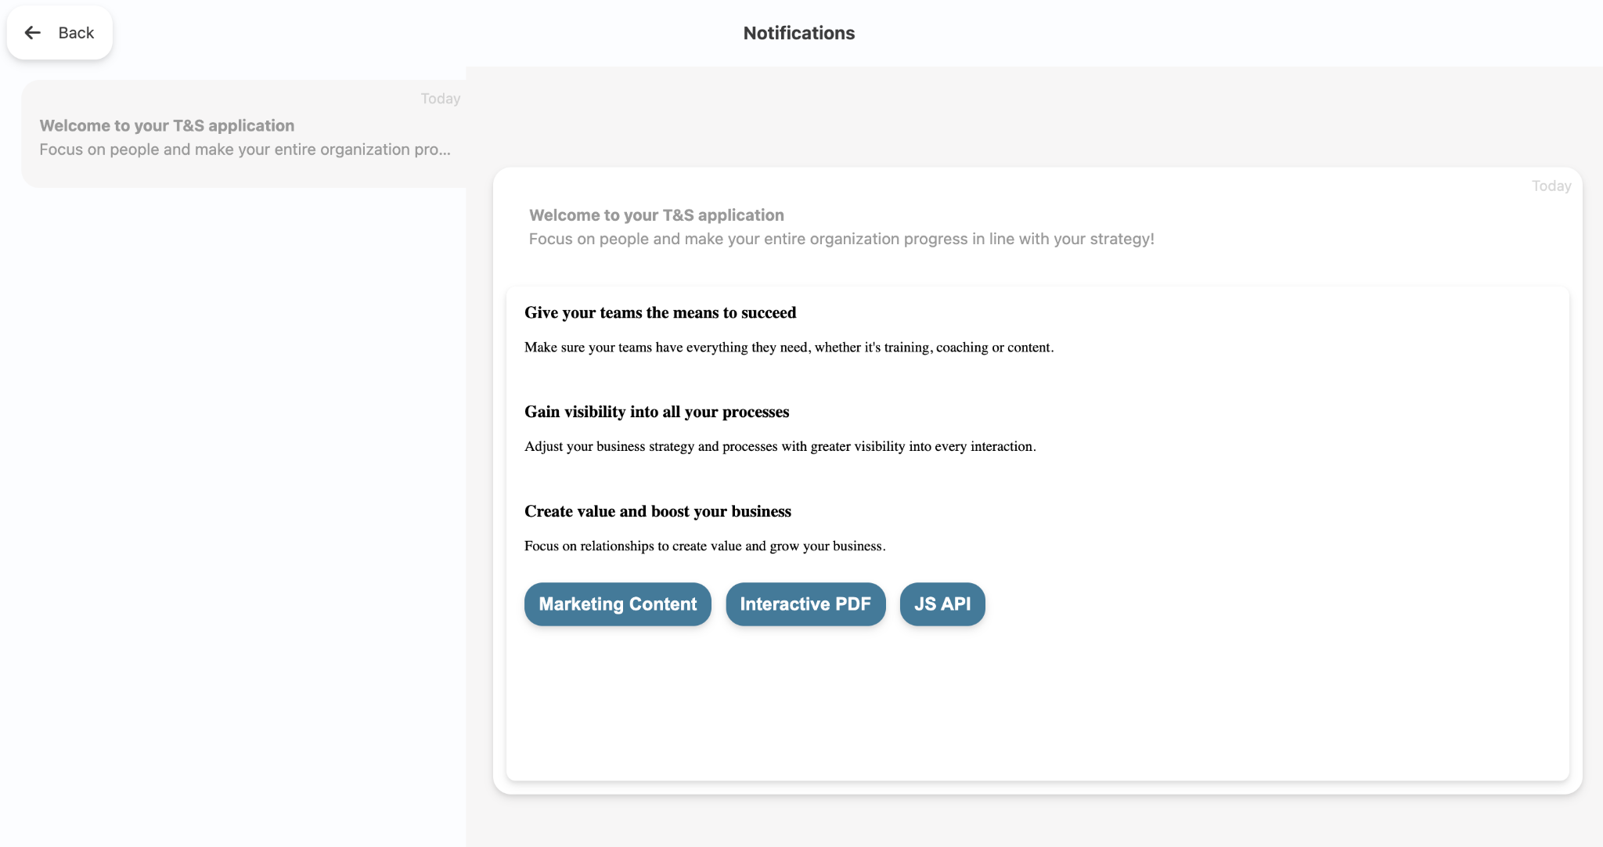
Homepage | Notifications
User Guide V8
A notification enables you to receive a communication from your administrator.
They can’t be deleted. You have access to new and old notifications alike.
When a notification is received or unread, a red disc is added to the application’s icon and menu until it’s opened.
Very practical when it comes to being informed of the availability of new content!
Back to contents

Slide 9
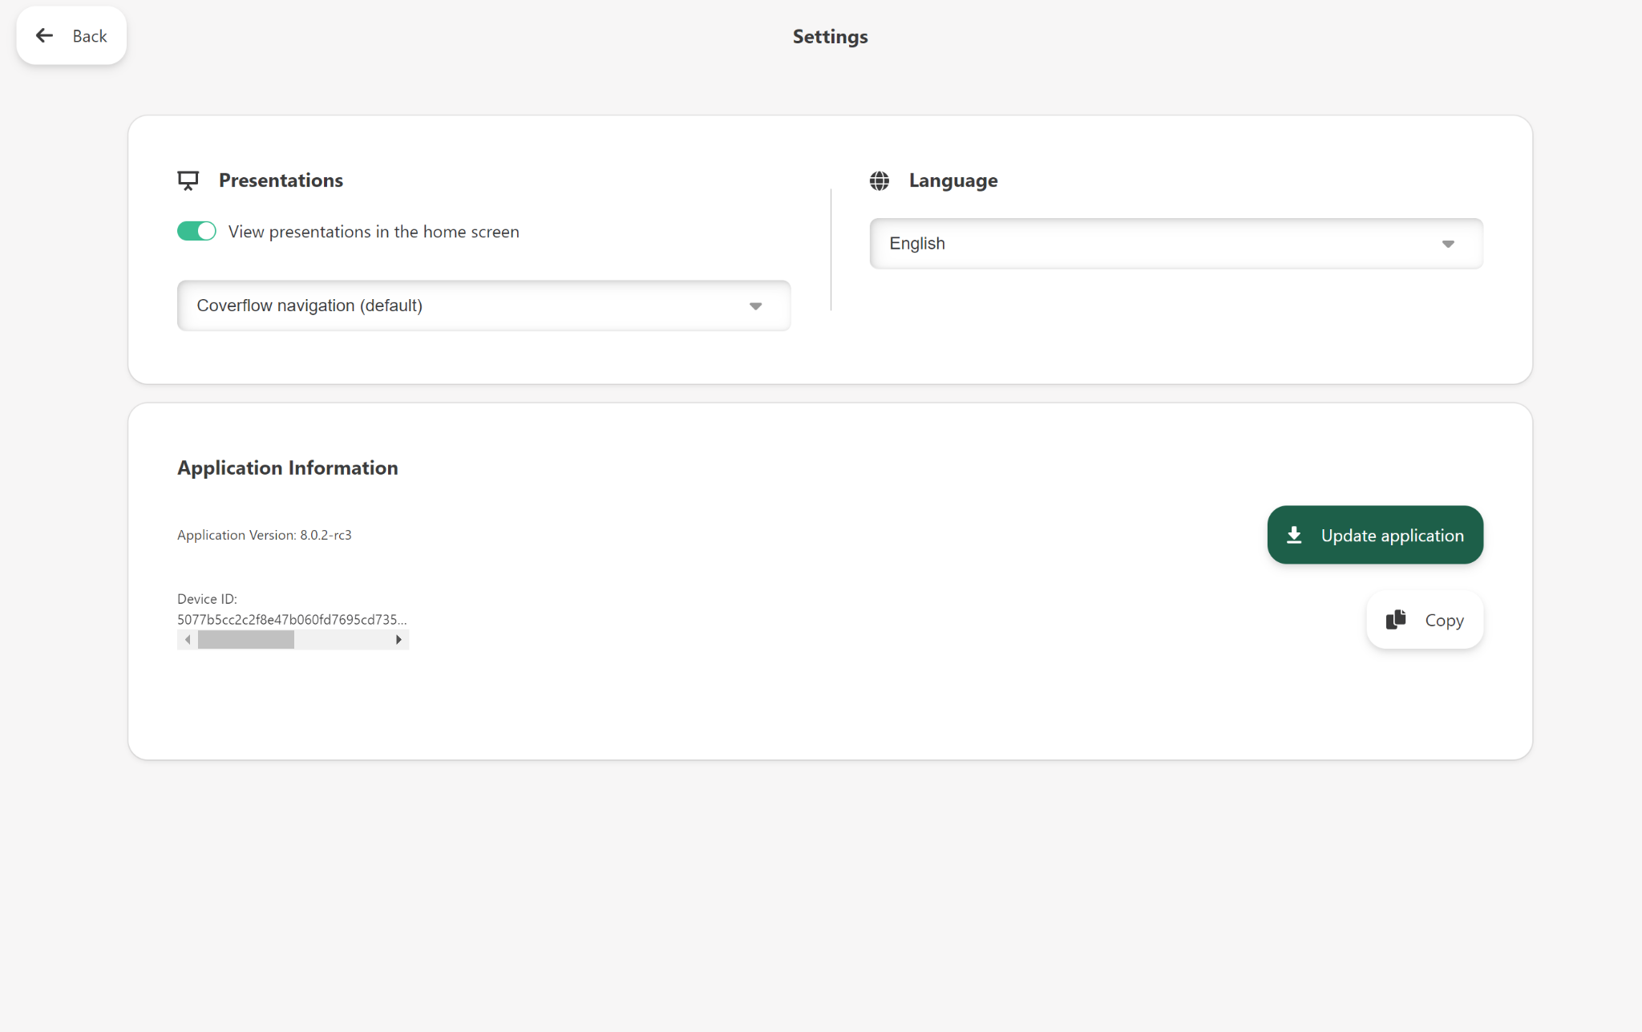
Homepage | Settings
User Guide V8
█ personalise your app’s graphic features
  Display appointments on homepage
  Browsing mode
█ technical information on your application
  Application version
  Device ID
NB: inform your administrator of this number in order to save time if you encounter a problem on your device.
Back to contents

Slide 10
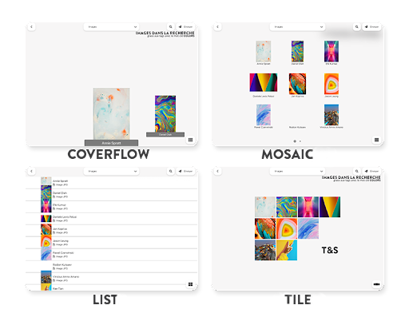
The 4 Browse Modes
User Guide V8
You have the choice of 4 browse modes:
COVERFLOW (horizontal scrolling, carousel)
MOSAIC (9 tiles with pagination)
LIST (vertical scrolling of thumbnails + names)
TILE (all components are displayed on the screen untitled)
For a specific folder or prepared presentation, you can change the browse mode by clicking on the button accessible in the menu (the button changes appearance depending on the next browse mode).
NB: your administrator can impose a browse mode for all folders.
Back to contents

Slide 11
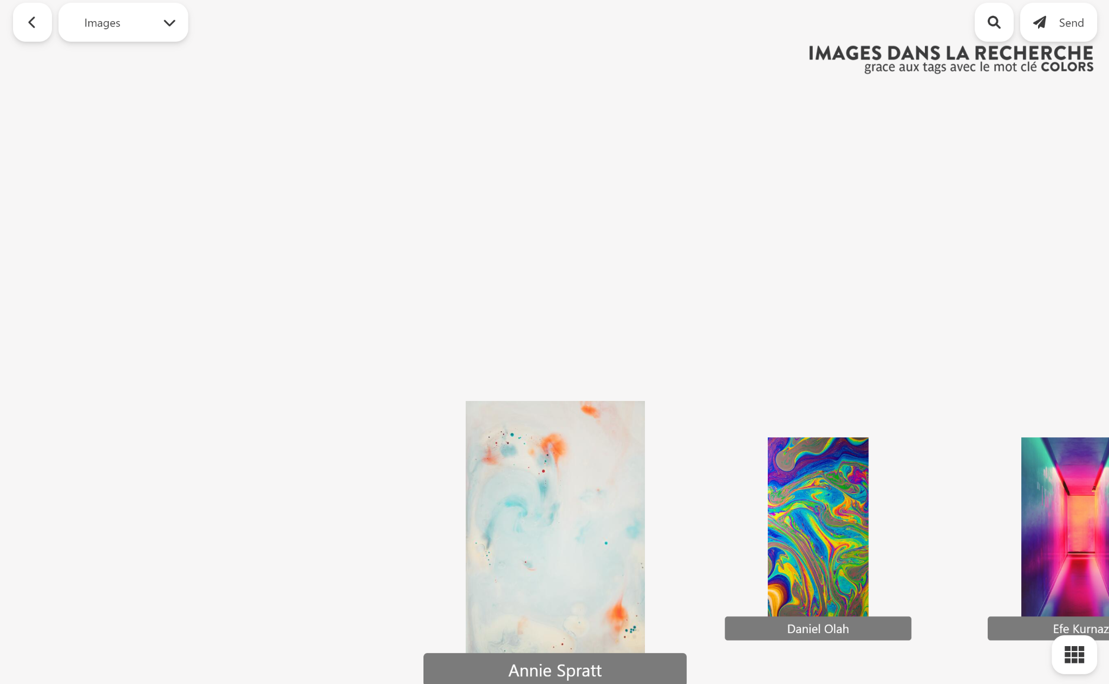
Browsing in the tree structure | 1/3
User Guide V8
Browsing within the tree structure is a simple operation:
To █ enter a folder or item of content, simply click on it.
To █ return to the previous screen, click on the Back chevron in the upper left-hand corner.
To █ browse in the tree structure, click on the breadcrumb trail.
To █ browse via search, click on the magnifying glass in the top right-hand corner. Your favourite content is directly available.
Back to contents

Slide 12
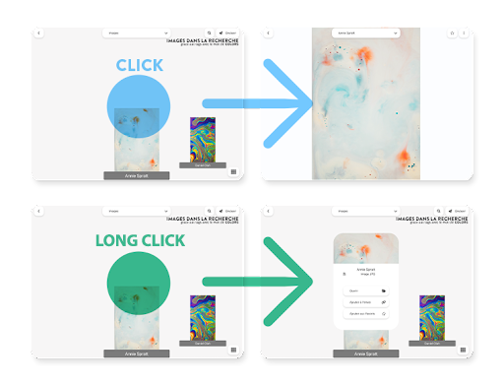
Browsing in the tree structure | 2/3
User Guide V8
The following actions are possible on the thumbnails:
█ Short click: opens the folder or content
█ Long click: opens the context menu
(Open document / Add to Send / Add to Favourites / Reload a modified PDF)
Back to contents

Slide 13
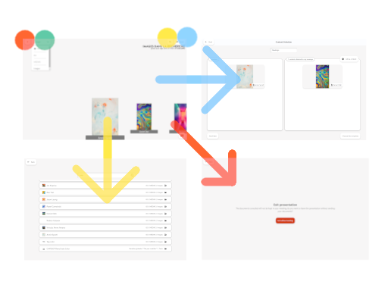





Browsing in the tree structure | 3/3
User Guide V8
█ Closes the presentation and returns to homepage: content added to the communication will be lost along with annotations.
█ Dropdown menu: know your location and browse among the various folders using the breadcrumb trail.
█ Search in content and folders: by title or by “tag”.
█ Send: access the content sharing screen.
Change browse mode
Back to contents

Slide 14

Offline Mode
User Guide V8
With your application, you can consult content at any time, even when you’re offline.
Once you’ve carried out synchronisation with an Internet connection, you can consult your application in offline mode, with the certainty that all your documents are up to date and downloaded onto your devices.
Back to contents

Slide 15
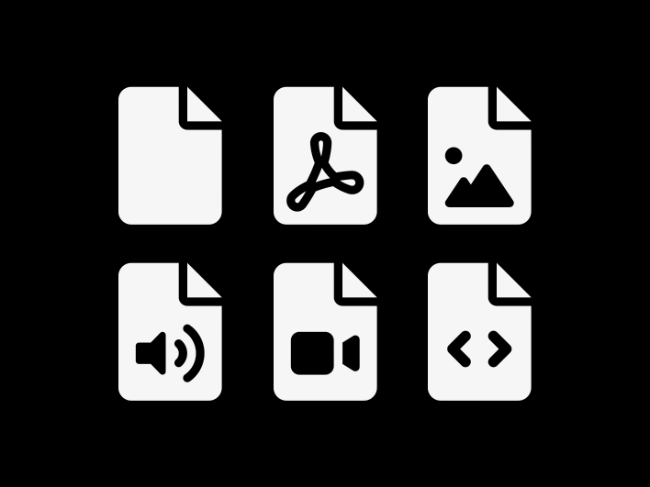
Supported content
User Guide V8
The application enables you to read many different types of documents:
Office: in Viewer mode only, possibility of opening outside the application, in order to edit docx, xlsx, csv and pptx
Media: mp3, wav, mp4, mov, m4v, mkv, avi, mpeg and mpg. Note that Flash Player has been disabled since January 2021
Images: jpg, png, gif, jpeg and svg
Interactive: PDF, Forms, Quizzes, and Web
Back to contents

Slide 16

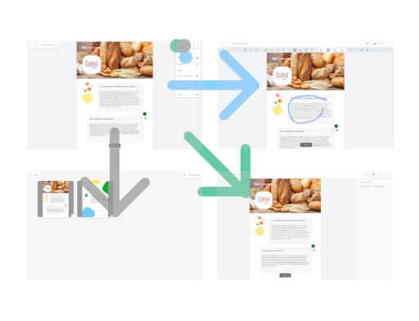
Managing a PDF | 1/2
User Guide V8
Various options are available for editing and sharing PDF content:
█ Annotations: it’s possible to make various annotations to content: text, highlighting, signature, image, etc. The original document remains unchanged.
█ Delete pages: select the pages that interest you in order to share relevant content. Click on the mosaic and you can browse and select pages.
█ Search for a term in the document by clicking on the magnifying glass; text entry enables rapid browsing in an item of content.
Back to contents

Slide 17
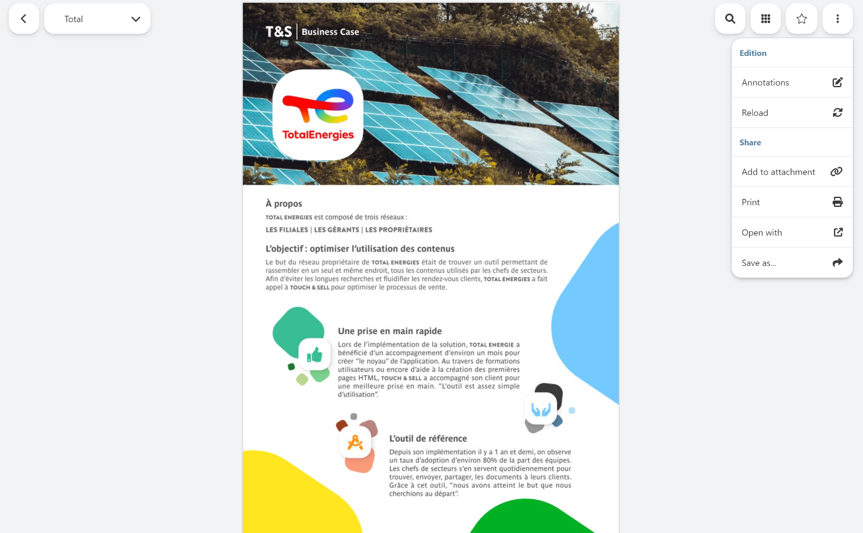
Managing a PDF | 2/2
User Guide V8
When viewing a PDF, various actions are possible:
█ Add to attachment: enables you to select content to share with your contact.
█ Open with: this feature opens the document in the corresponding application, so that it can be managed outside the application.
Back to contents

Slide 18

Microsoft Office content
User Guide V8
Office content can be read from the application.
Editing is carried out from the “Ouvrir avec” (Open with) secondary menu. You can open content in an application dedicated to content editing. Resulting edits will not be stored in the application.
It’s also possible to search within the document.
NB: contact your administrator if you don’t have access to this feature.
Back to contents

Slide 19
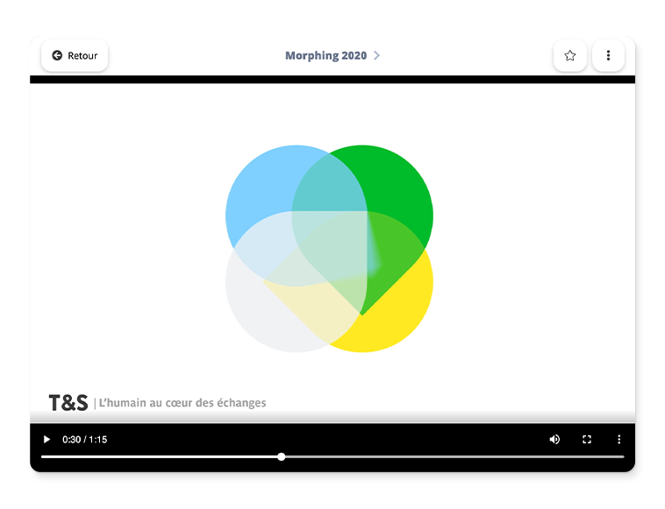

Media
User Guide V8
Audio, video, image… all the most popular forms of content can be used with the application.
Content can be looped, depending on the Studio’s options (“tag loop”).
Back to contents

Slide 20
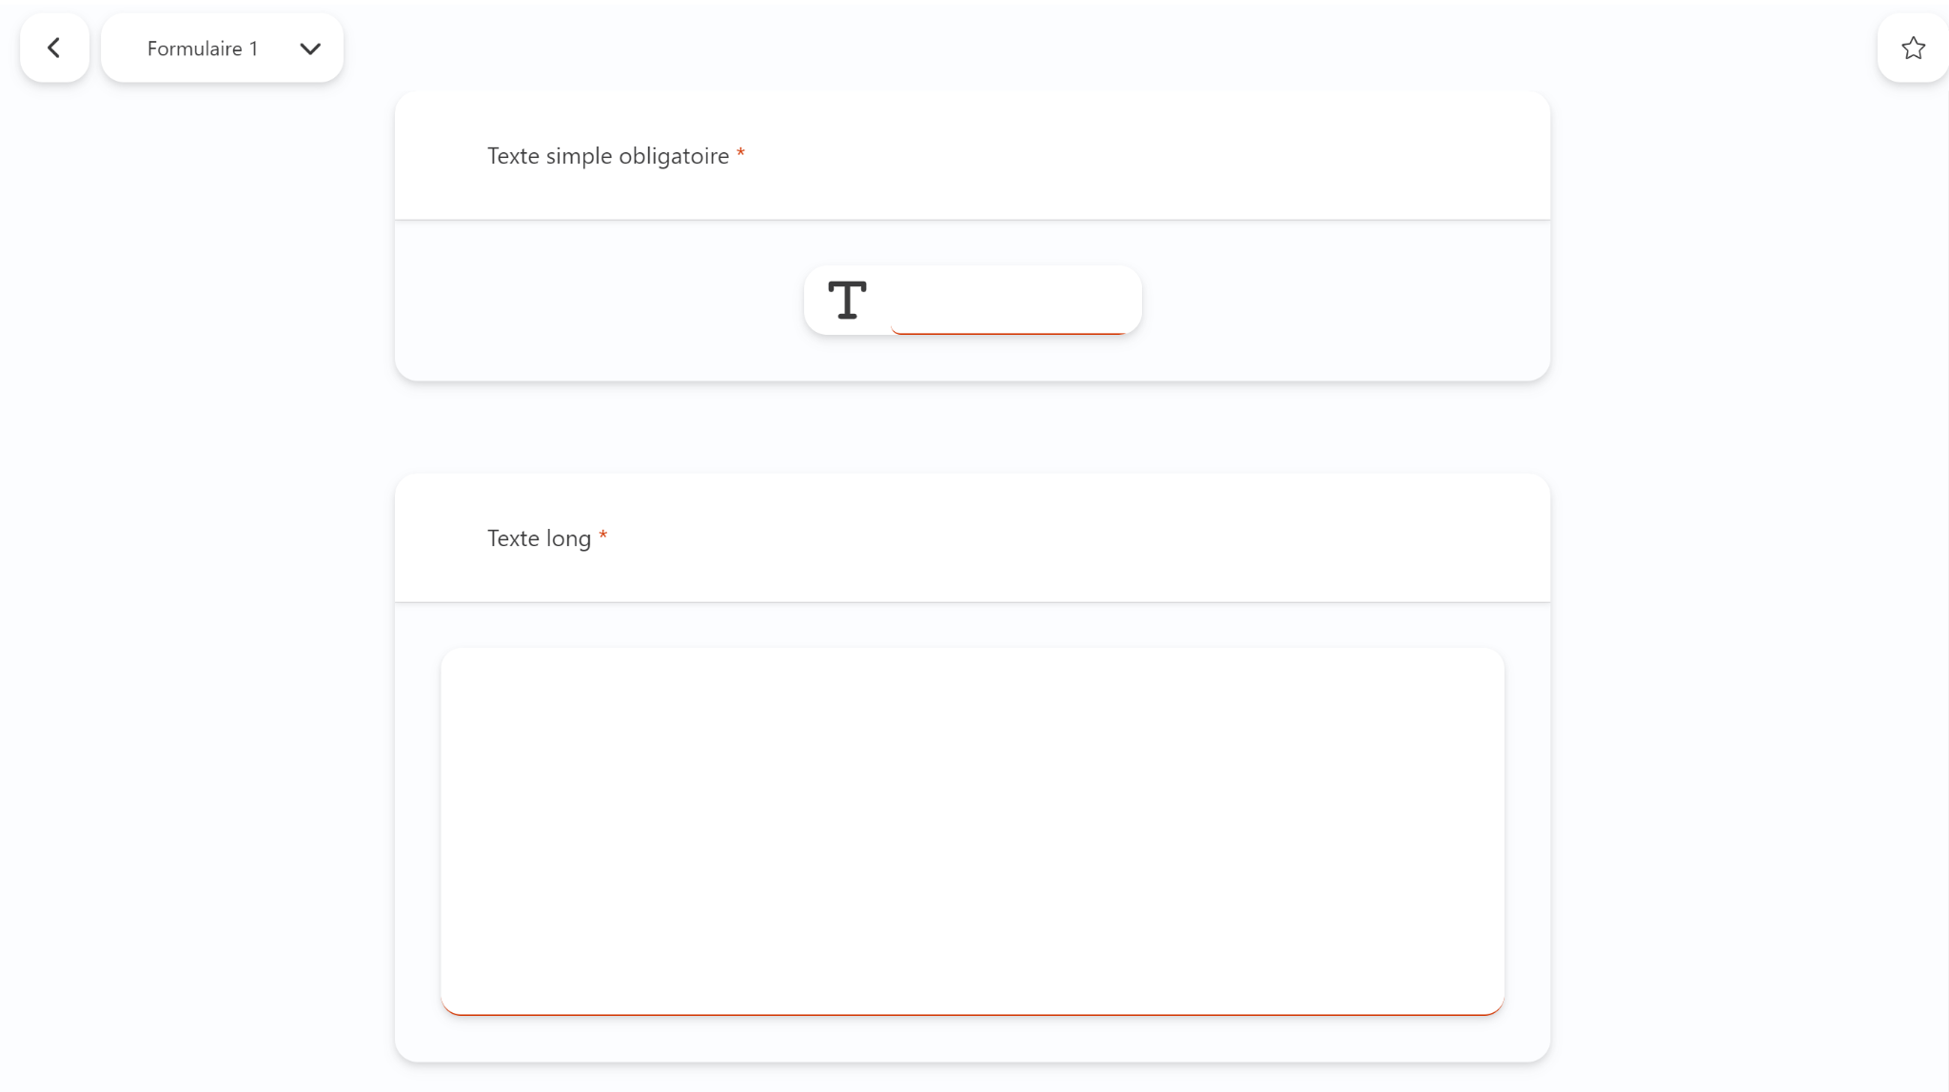
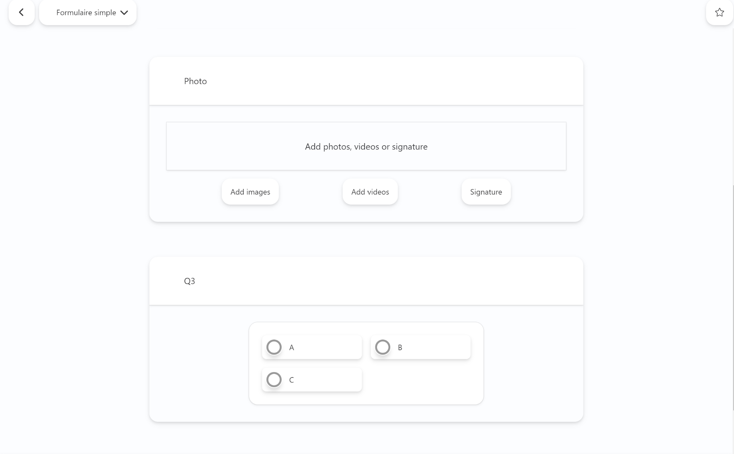
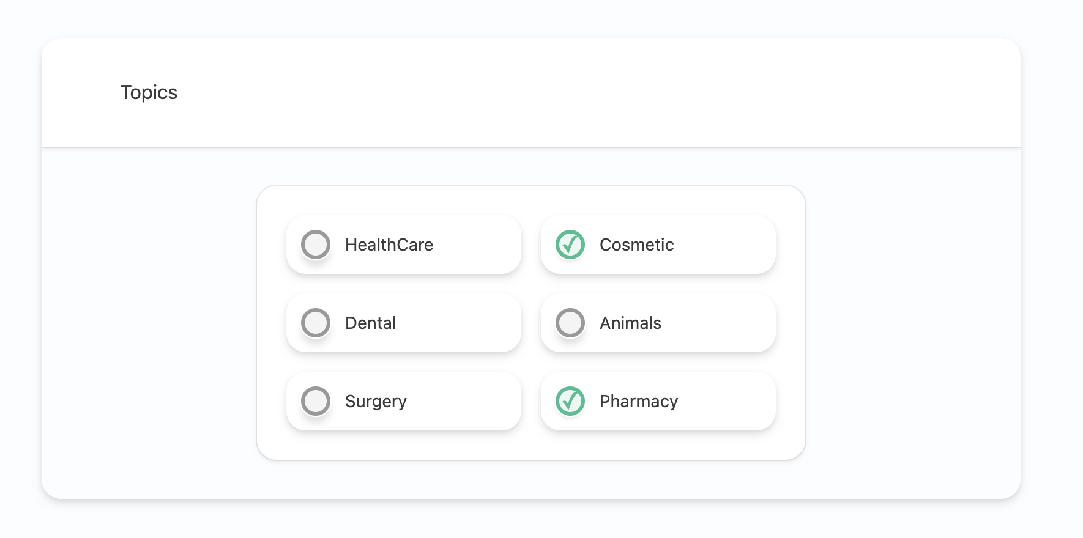
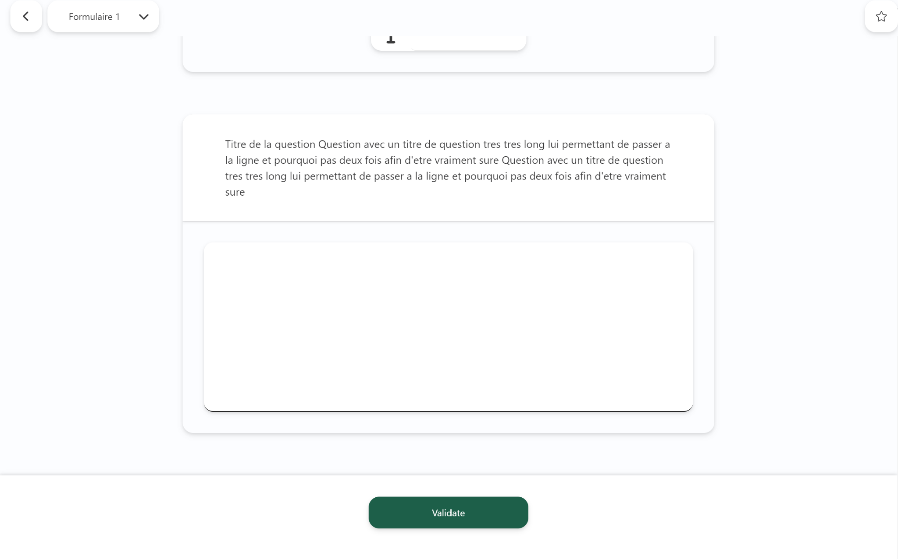
Forms
User Guide V8
Form content enables data to be sent back direct from the field.
It’s also possible to send back media (videos, images, signature) and quiz-type data.
Answers to questions are communicated to the back office for exploitation by your administrator.
Back to contents
Notes:
A modifier avec les formulaires regroupés

Slide 21
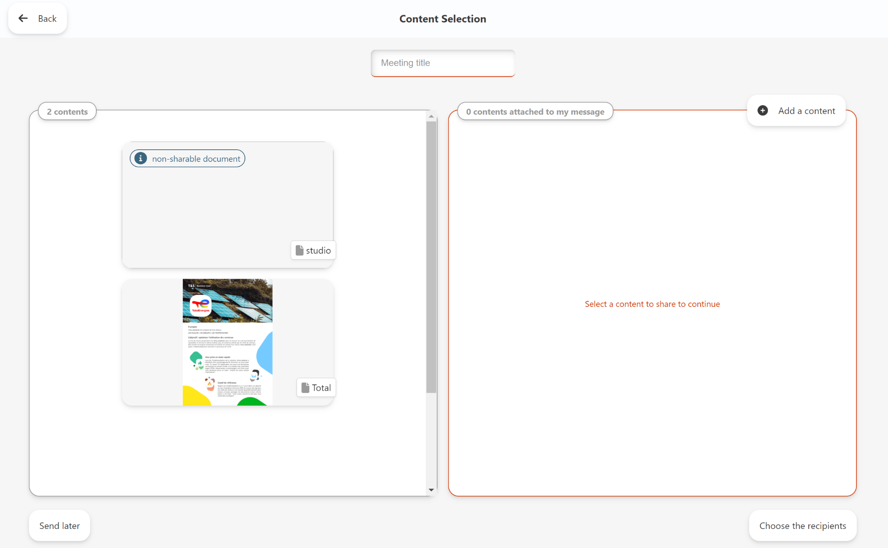
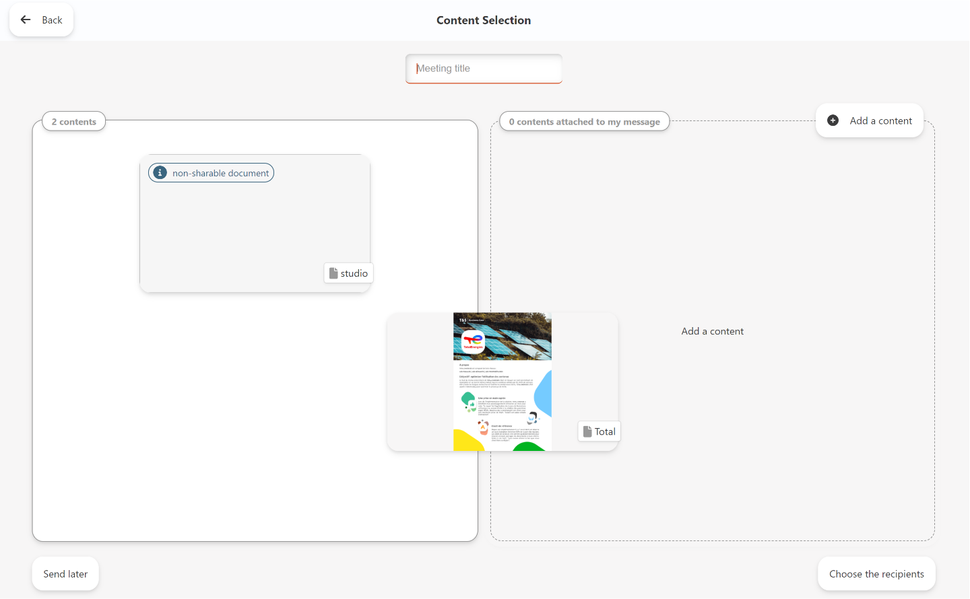
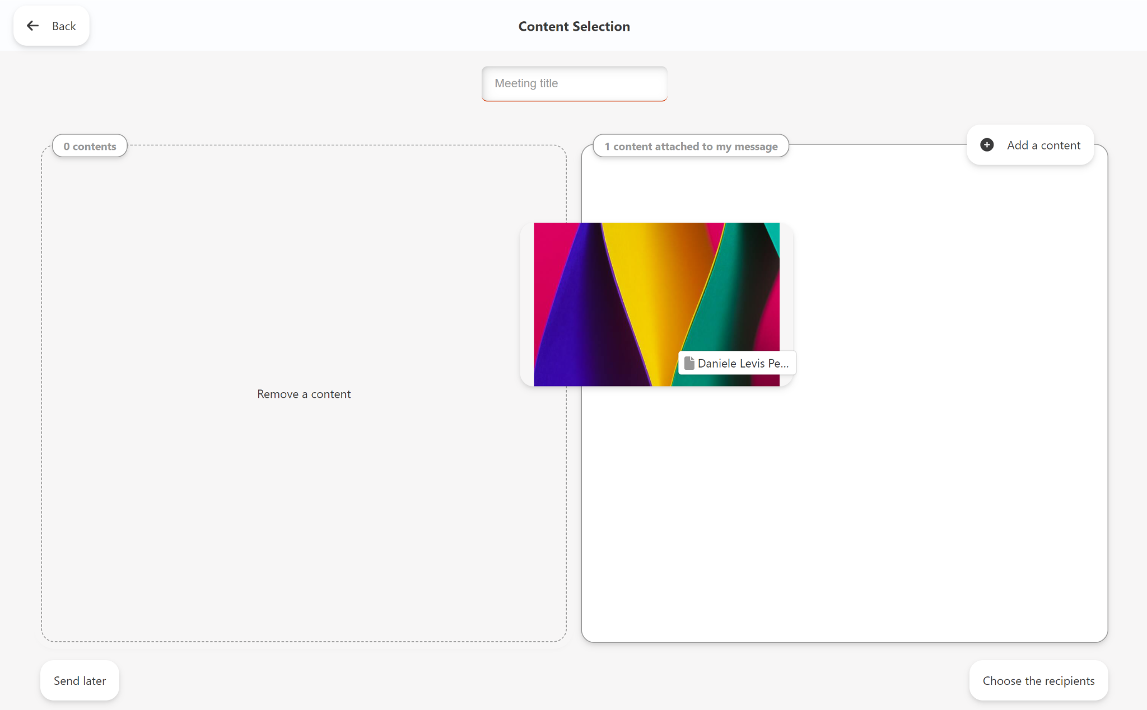
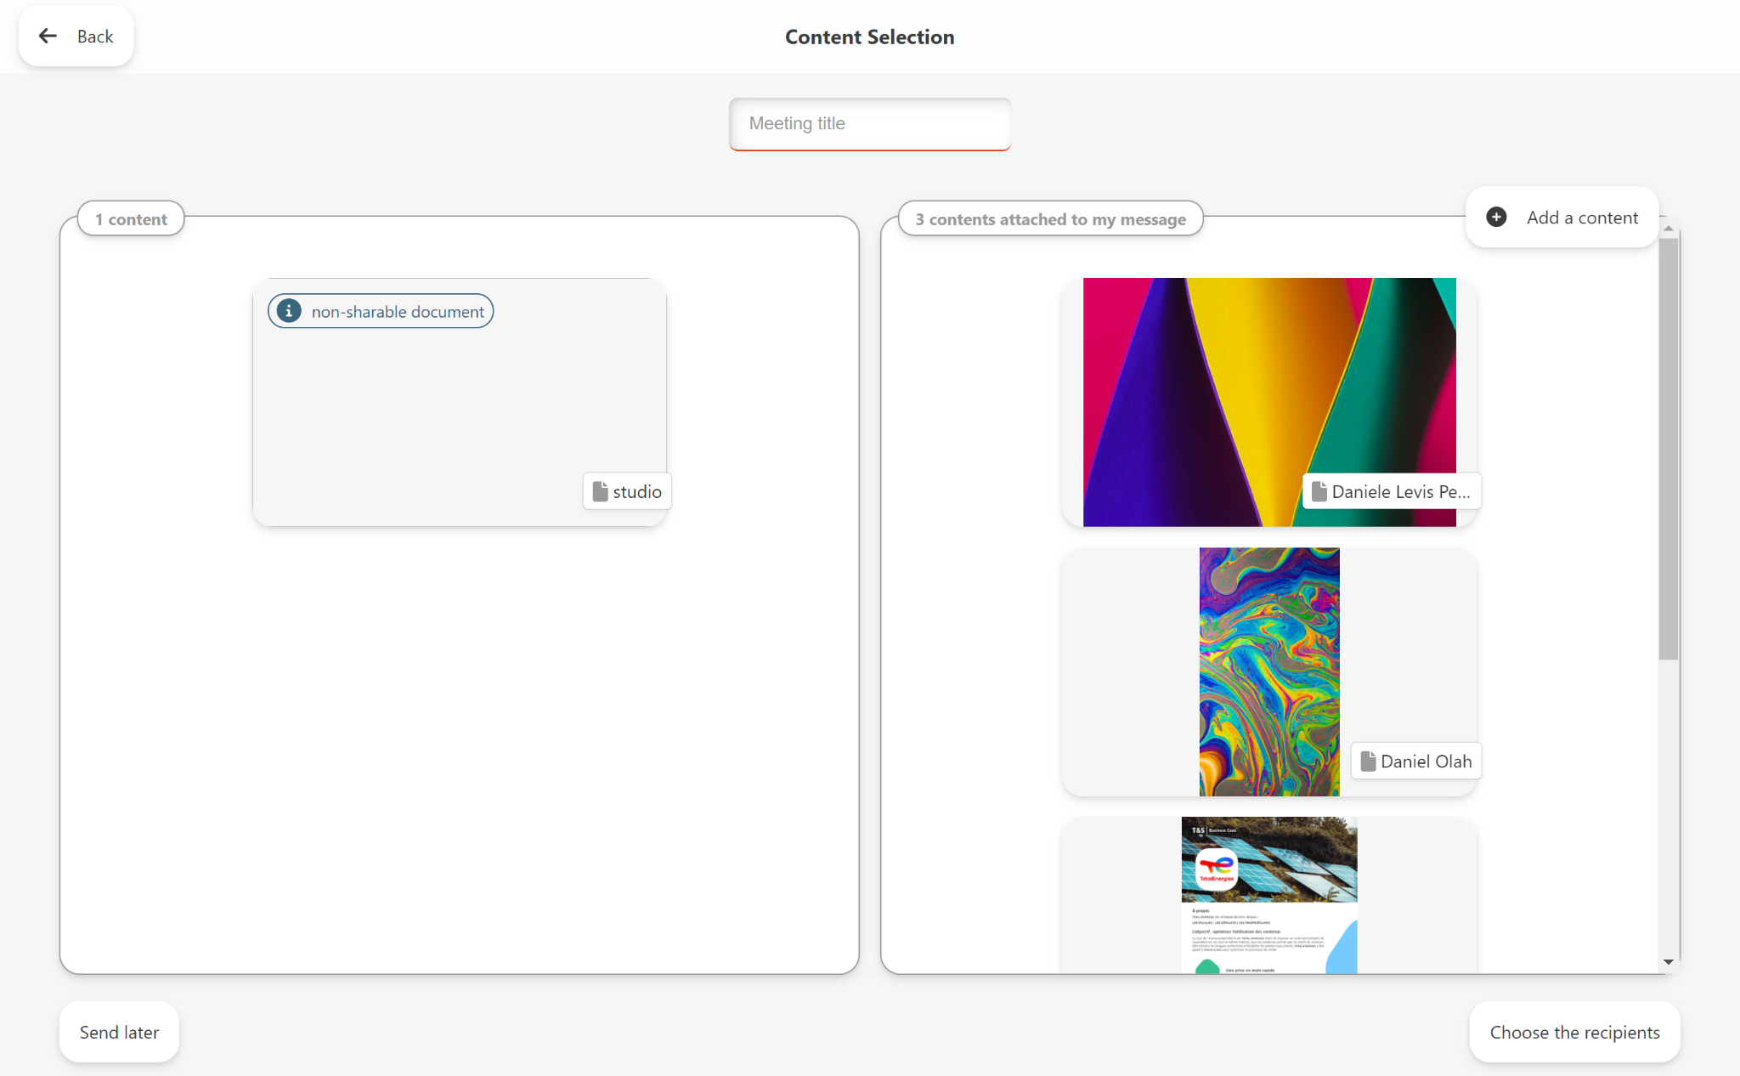
Sharing | Selecting content
User Guide V8
At the end of a presentation, all content viewed during your presentation is grouped together on a screen.
You can consult and select it before sending.
To add content, you can:
Select an item of content and slide it into the right-hand column Content attached to message
Search for an item of content by clicking on the Add content button
To confirm the selection, the user can give their presentation a title.
Back to contents

Slide 22
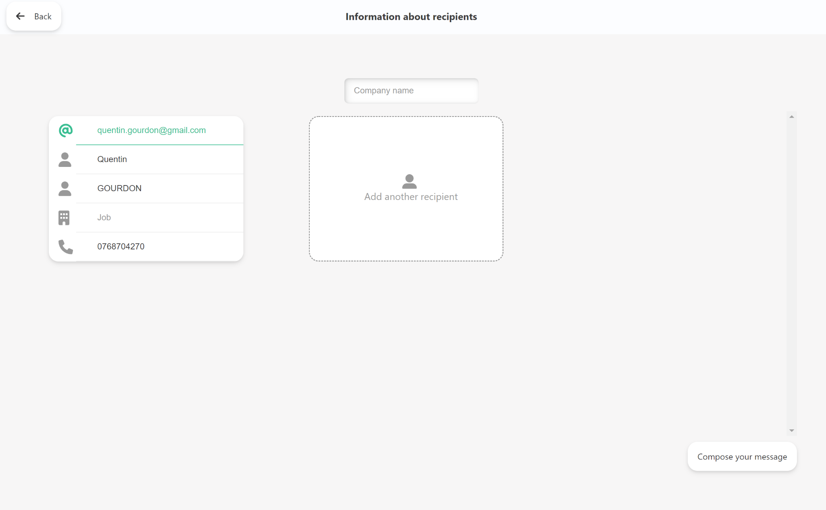
Sharing | Adding recipients
User Guide V8
After selecting content, you can add as many recipients as necessary.
Information complementary to the email can be added:
Name
Position
Telephone number
This information can be synchronised with the company’s CRM.
Back to contents

Slide 23
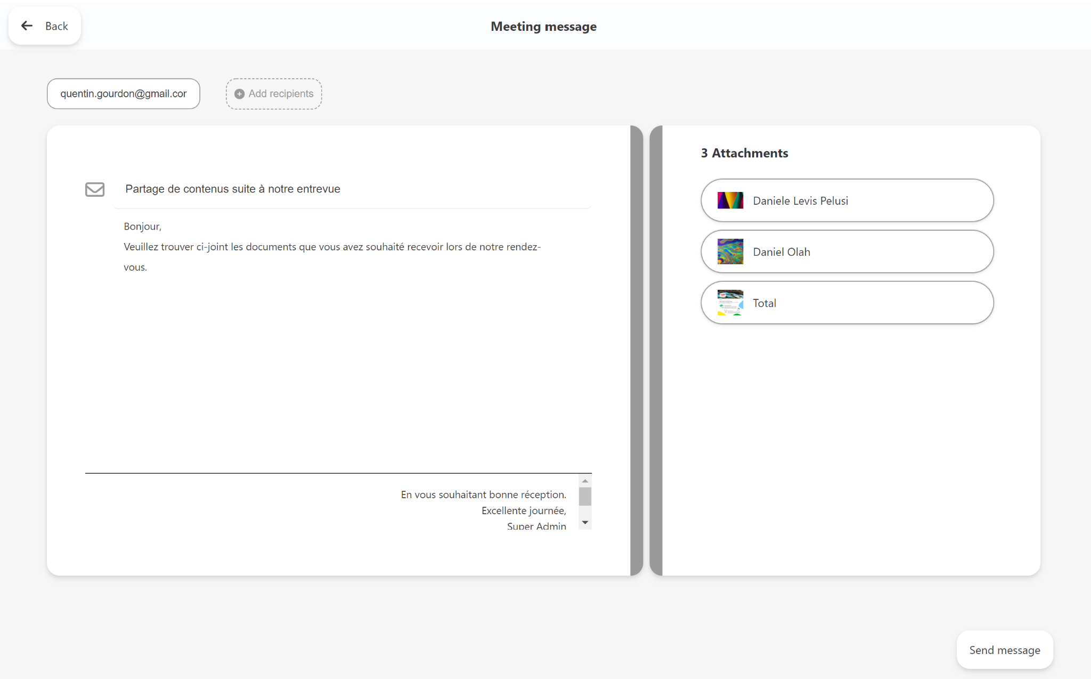
Sharing | Composing your message
User Guide V8
The user can personalise their message on the message composition page.
Information (Subject, message body and signature) can be synchronised from the Studio depending on the solution’s settings.
These fields remain personalisable at this stage.
Content attached to the message is displayed; it’s possible to consult it before sending.
When you click on the Send button, an email will be sent to your interlocutors.
The user can find the exchange concerned in the Appointment Options’ “Archives” section.
Back to contents

Slide 24
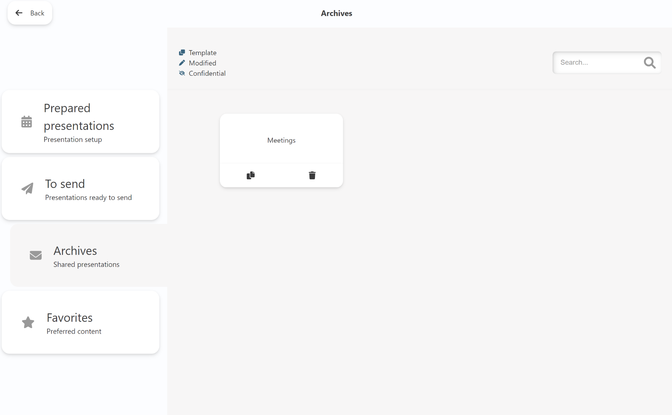
Sharing | Sharing content, continued
User Guide V8
The “Archives” section in Appointment Options contains
all shared content.
When you share content, your recipient receives an email containing a link to a personalised webpage from which
they can download all documents viewed and selected.
You’re informed by email when your contact consults
and/or downloads content.
Back to contents

Slide 25

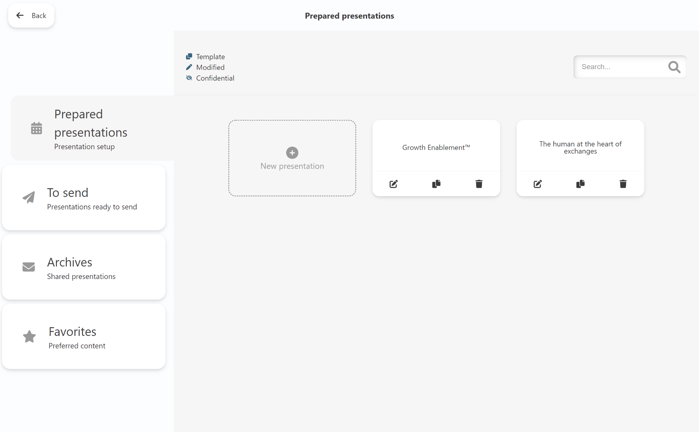
Presentations
User Guide V8
There are 3 different statuses:
Prepared: this is a presentation
prepared by the user.
To send: this is a presentation
that’s been recorded in order to be sent
later, after an appointment, with the possibility of modifying the attached content and personalising the message before sending.
Archives: this is content already shared. The user finds all content viewed during the appointment, content shared and the message.
Back to contents

Slide 26

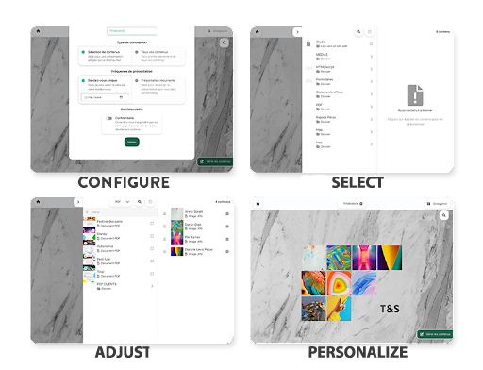
Prepared Presentations
User Guide V8
Presentation preparation enables you to select content prior to your appointments.
The configuration provides for two types of creation.
Selection provides for list browsing in the application’s tree structure. Searches as well as breadcrumb browsing are possible, as in a presentation.
Adjustments are possible, providing for sorting of appointment components and removal of this or that component.
Content personalisation is possible. You can also browse in your personalised appointment.
Back to contents

Slide 27
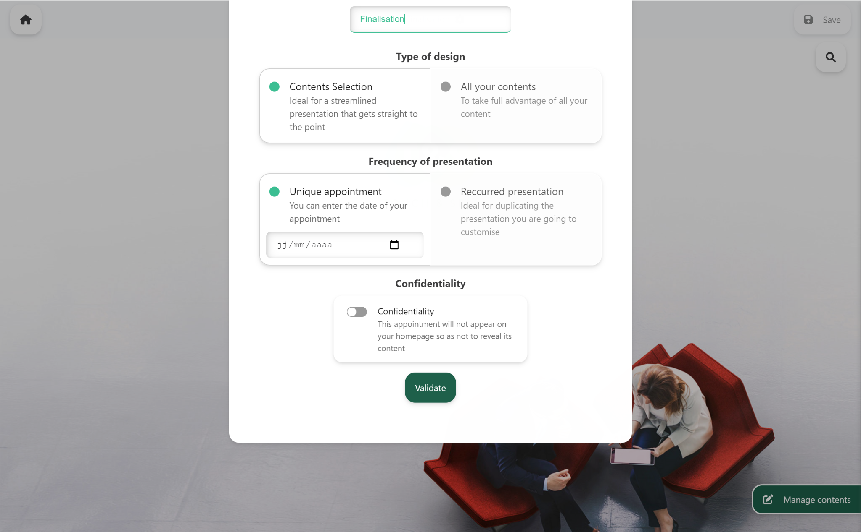
Creating presentations | 1. Configuring
User Guide V8
The first appointment creation screen presents all the settings available for an appointment.
You must enter a title.
You can then choose your type of design: “Content selection” or “All your content”.
You can personalise content for a specific appointment, mixing it with all available content.
You can then choose your “Presentation frequency”: “Single appointment”or “Recurrent presentation”. A recurrent presentation can be very useful for repetitive formats.
The appointment can be confidential, in which case it won’t be displayed on the homepage, but only on the appointment management screen.
Back to contents

Slide 28
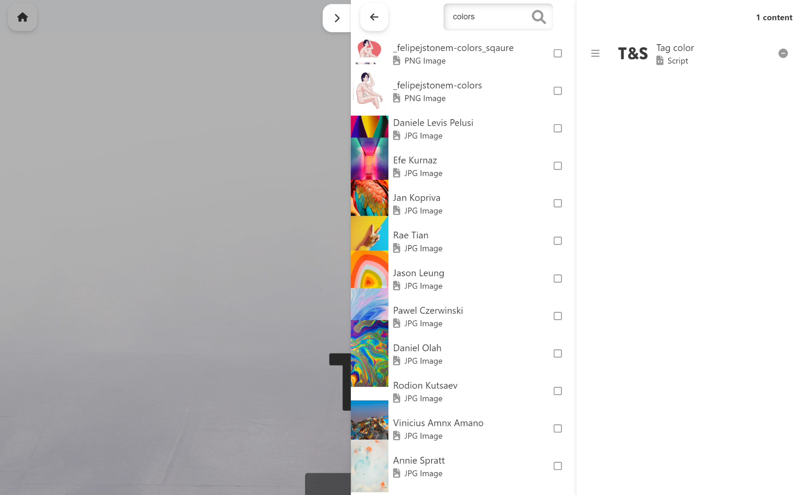
Creating presentations | 2. Selecting
User Guide V8
Once the form has been completed and confirmed, you’ll
have access to the content selection panel.
You browse using the breadcrumb trail, by searching, or by clicking in your tree structure.
When content is ticked, it’s added to your appointment’s recap screen.
You can: Add, Delete, Sort.
Back to contents

Slide 29
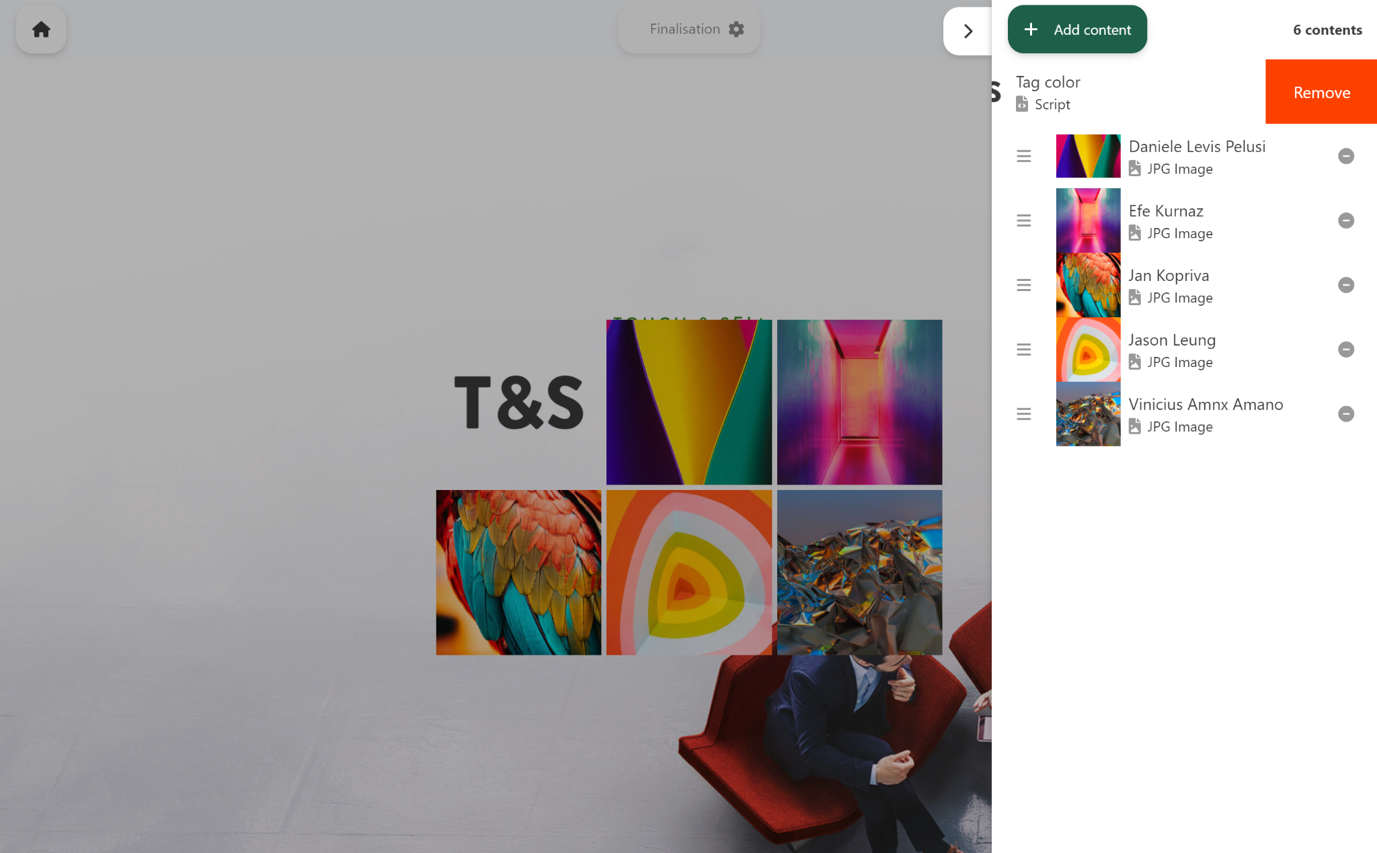
Creating presentations | 3. Adjusting
User Guide V8
Your appointment is starting to take shape!
When you press outside the panels or on the cross on the
top left, the menu closes.
If you want to add extra content, no need to panic!
You can come back and modify your presentation whenever you wish.
Back to contents

Slide 30
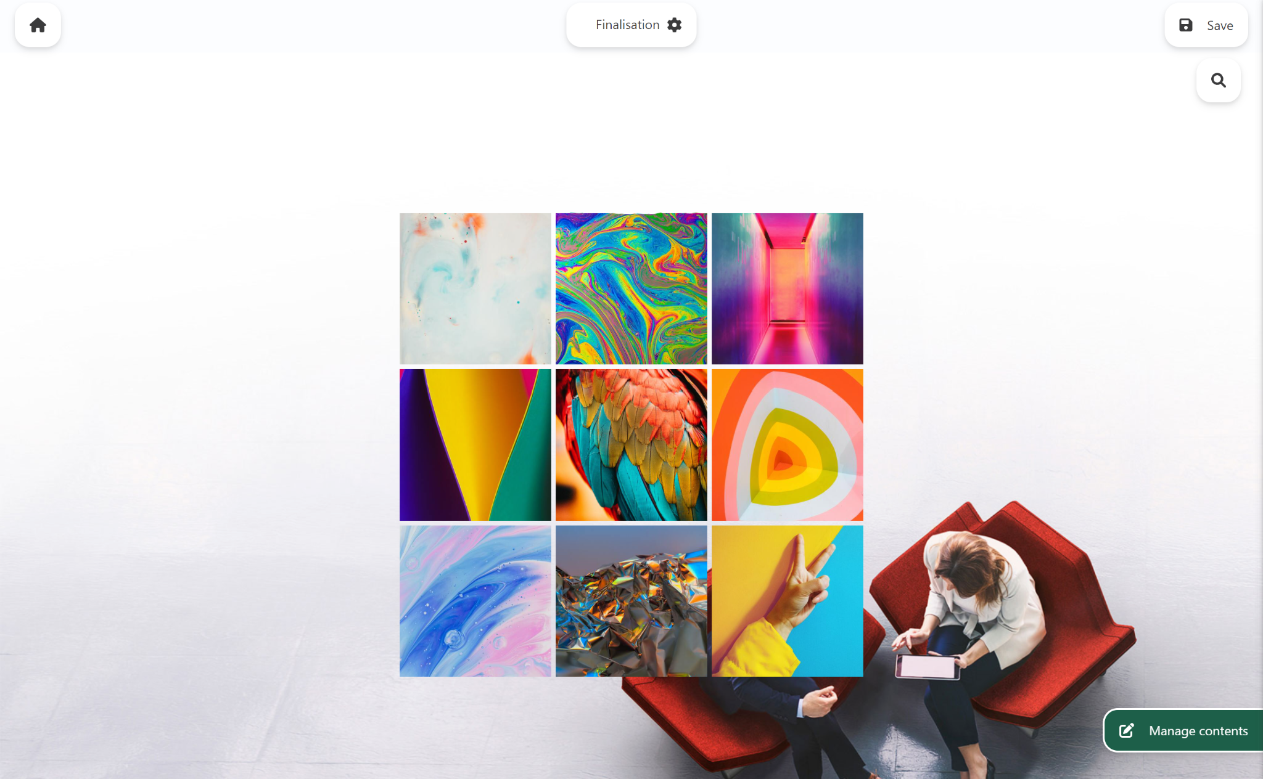
Creating presentations | 4. Browsing & Personalising
User Guide V8
When your appointment is ready, all you have left to do is
test it out.
You can annotate your PDFs and select pages. Modifications made to your documents will be kept until the day of your scheduled appointment.
It’ll still be possible to modify your “prepared” appointment after you’ve recorded it.
NB: your documents will be updated automatically if your administrator disseminates new versions.
Back to contents

Slide 31

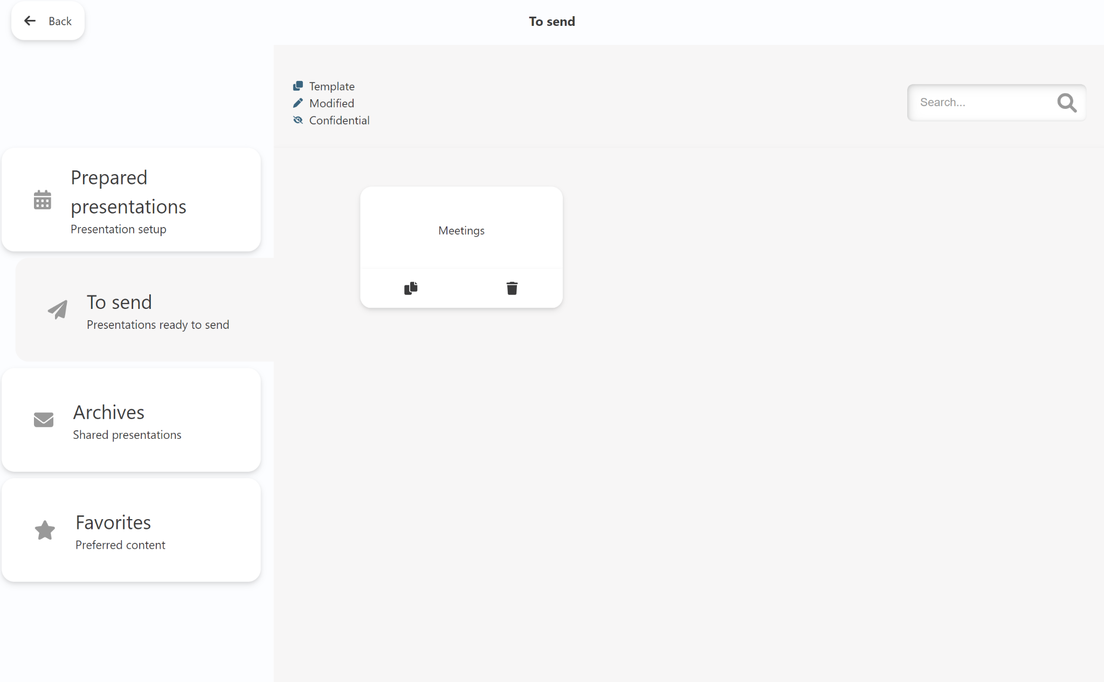
“To Send” Presentation
User Guide V8
To send presentation enables you to save a selection of content to share for later communication.
Back to contents

Slide 32

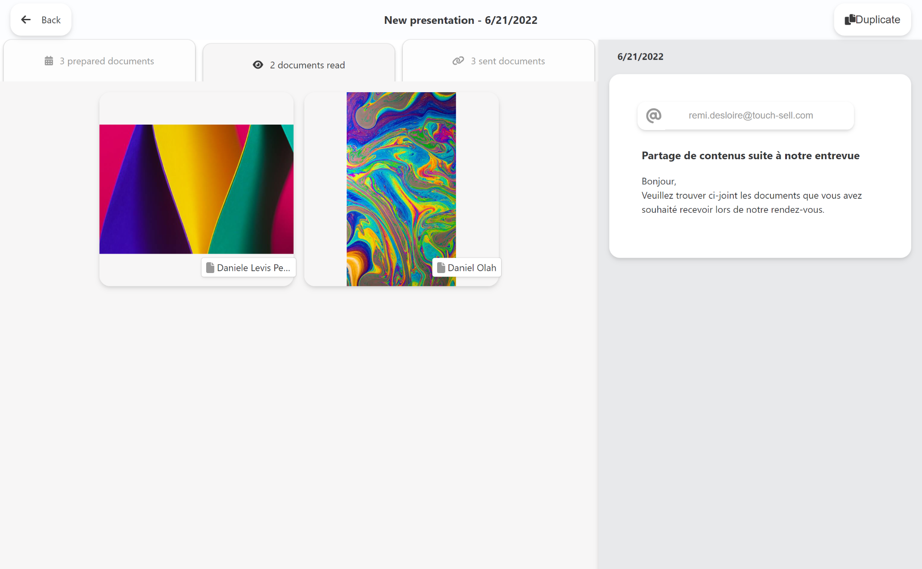
“Archives” Presentation
User Guide V8
Archives list your previous content sharing operations.
An archive enables you to consult:
Content presented
Content shared
Your recipients’ information
The message relating to the shared content
An archive can be duplicated:
As a new “prepared” presentation containing prepared content ready to be presented.
As a new “to send” presentation containing shared content ready to be sent.
Back to contents

Slide 33

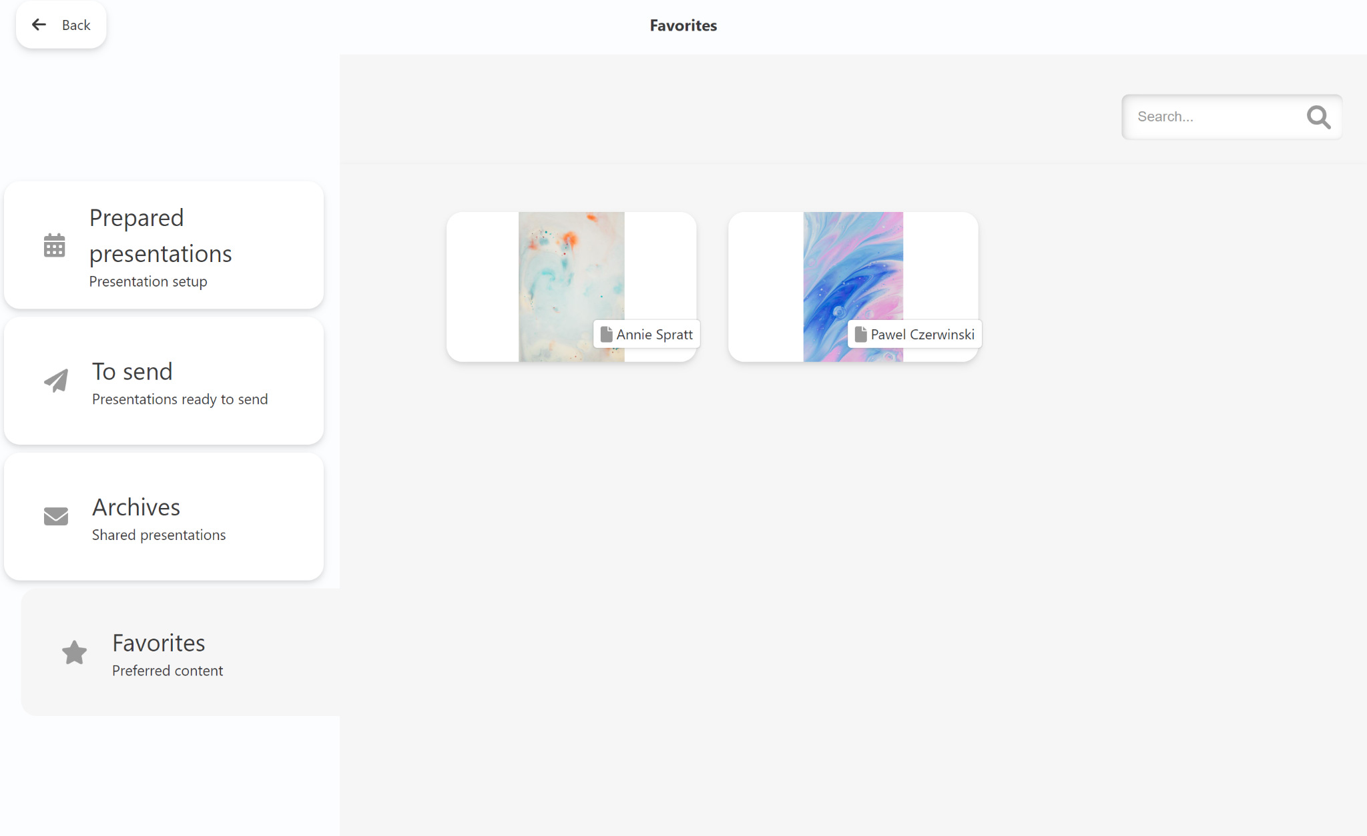
Your favourites
User Guide V8
You can add content to favourites.
There are two ways of doing this:
From the content concerned, click on the star, the icon fills up and the content is added to favourites. The same procedure removes the content from favourites.
From the tree structure, long click on the content concerned, click on the star, and the content is added to favourites. The same procedure removes the content from favourites.
Favourite content is available from:
Appointment Options > Favourites: there’s no need to go into the presentation in order to consult an item of content.
Search in the presentation: find favourite content under the search bar for direct access.
Search in content selection: find favourite content under the search bar.
Back to contents

Slide 34

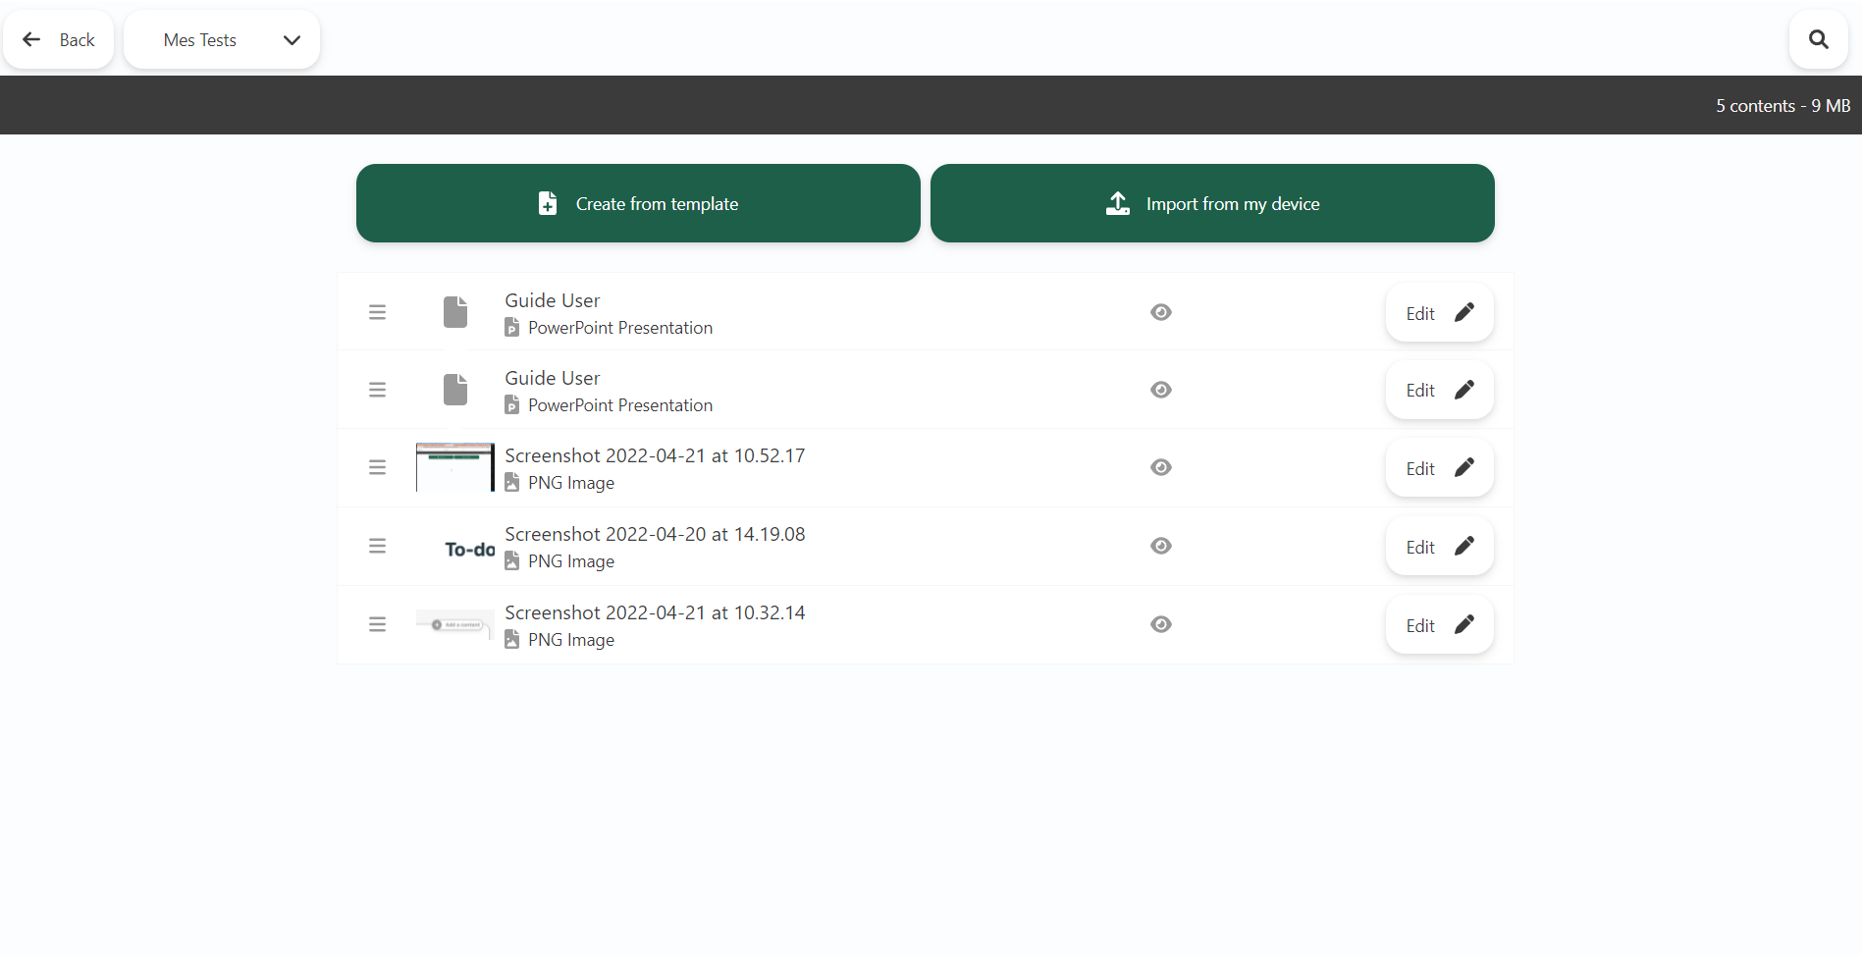
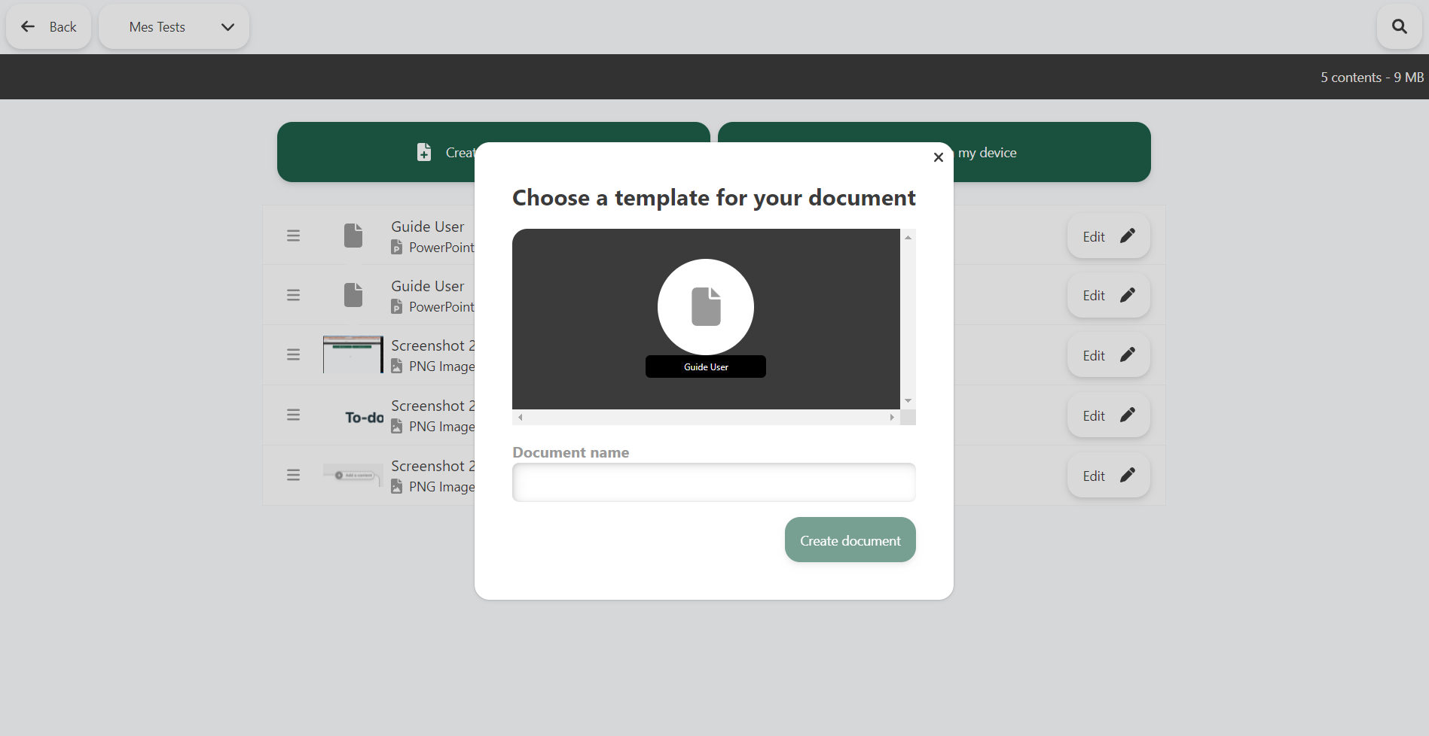
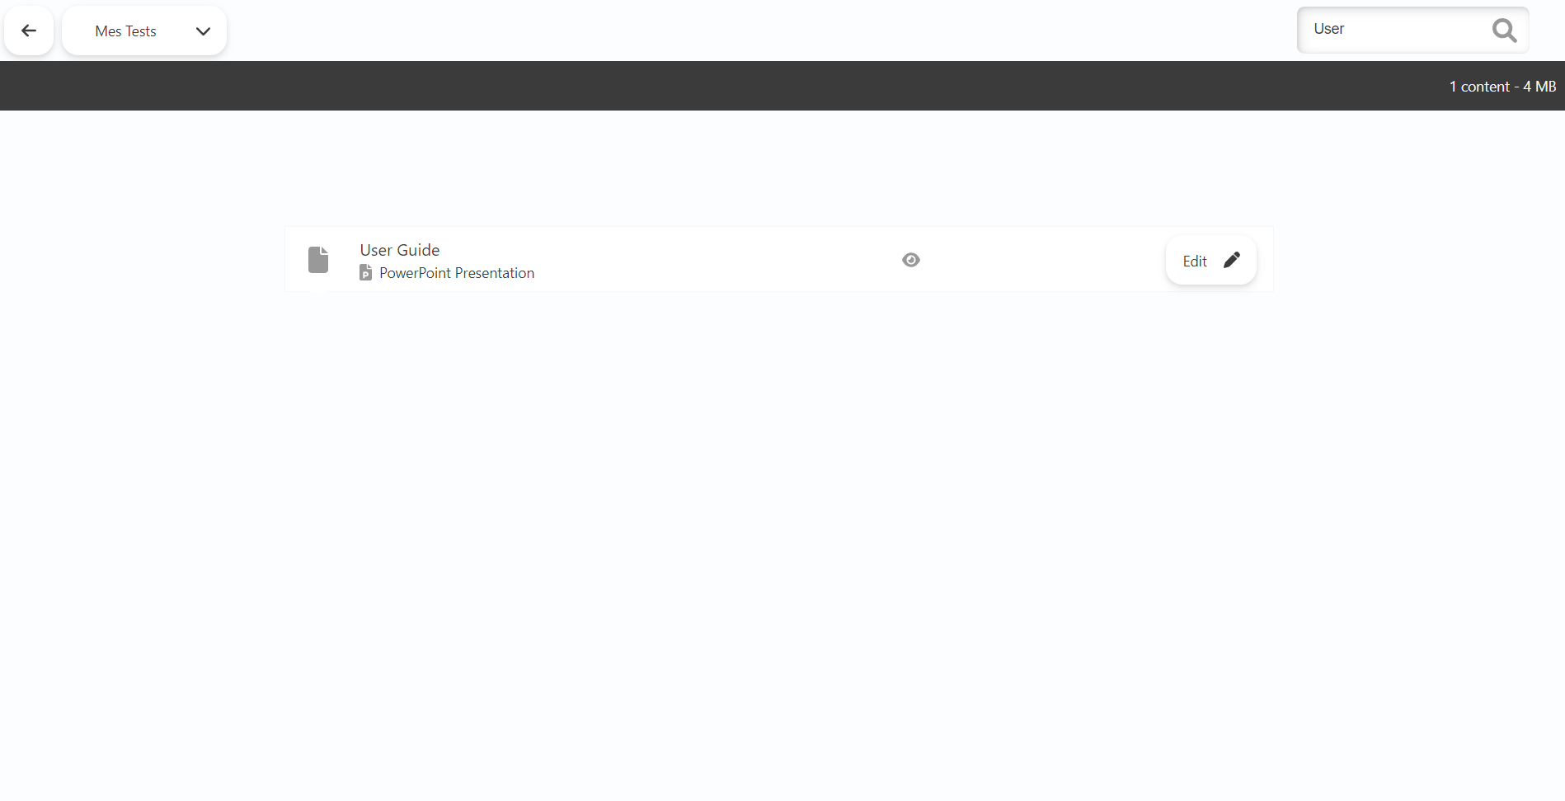
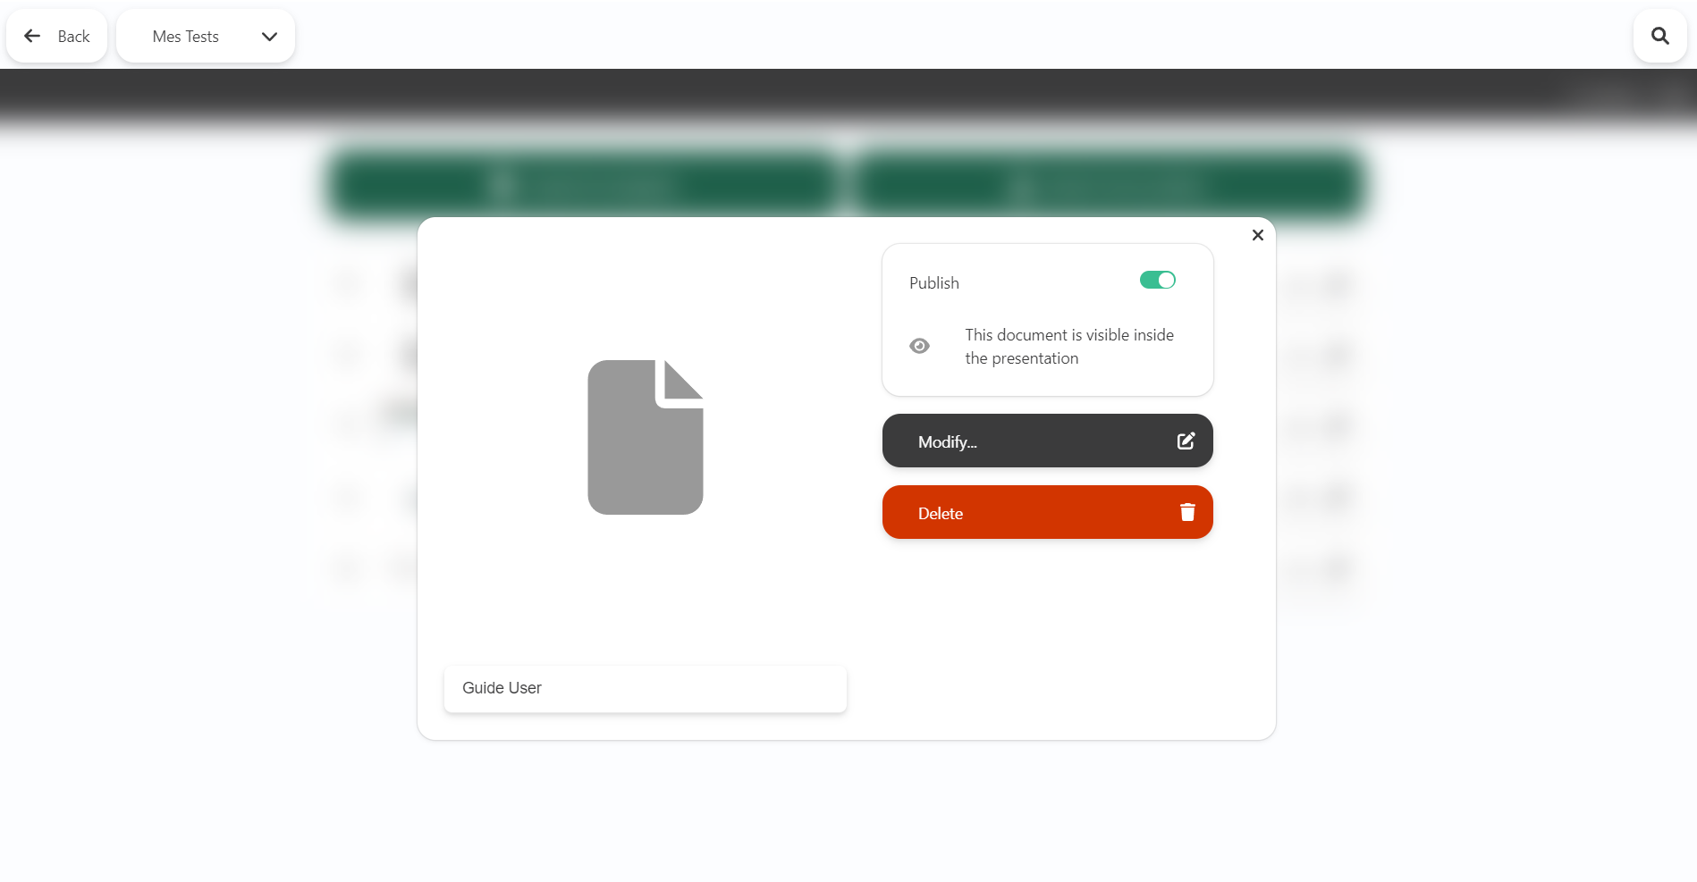
Your User Space
User Guide V8
The User Space enables you to :
Download files from your device.
Personalise content directly from the application.
Create new content based on existing templates made available by your administrator (ppt, docx, xlsx, etc.).
Back to contents

Slide 35


Updating your application
User Guide V8
When you update, you benefit from the latest innovations and features, and all the corrections and optimisations made to your application.
To update the application, go to the page communicated by your administrator (e.g. https://bo.touch-sell.net/XXX/app).
Two updating methods:
Minor application update: no action required. The update is carried out during a synchronisation
Major application update (about every 6 months): you or your CIO must install a new package. No need to re-synchronise all the content!
Back to contents

Slide 36
Your comments and suggestions on the platform are invaluable.
Write to us: contact@touch-sell.com

